Slide 1
Personalizing Marketing Through Customer Segmentation
Leveraging Data-Driven Insights for Targeted Strategies
Customers
Ingrid Nyakerario
Data Scientist & Business Strategist

Slide 2
Problem vs. Opportunity: The Marketing Strategy Gap
Broad Messaging
One-size-fits-all campaigns that ignore customer diversity
Customer Insight
Segment customers using behavioral and demographic data for tailored outreach.
1
1
Low Engagement
Generic offers don’t resonate, leading to poor click-through and conversion rates.
Higher Engagement
Personalization increases response rates and brand loyalty.
2
2
Wasted Spend
Marketing budgets are drained on ineffective, untargeted efforts.
Optimized Spend
Resources are allocated to segments with the highest return potential.
3
3
In a noisy market, relevance wins

Slide 3

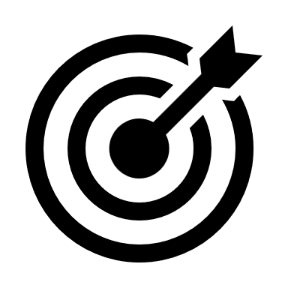
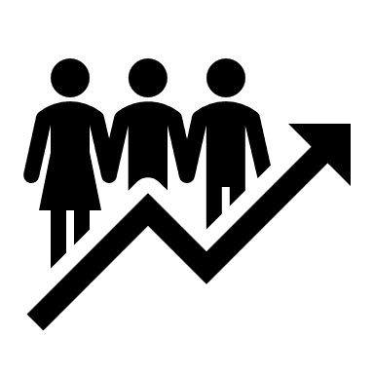
Unlocking ROI with Smart Targeting
Better Targeting
Understanding customer segments allows businesses to tailor messaging, offers, and products to real needs
Data-driven personalization boosts loyalty, reduces churn, and maximizes lifetime value.
Higher Conversions
+20% ROI

Slide 4

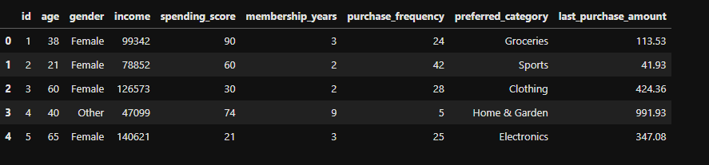
Meet the Customers: The Dataset at a Glance

Slide 5
Meet the Customers: The Dataset at a Glance
Last Purchase Amount – What are they spending?
Age & Gender – Who are our customers?
Membership Years –
How long have they been with us?
Annual Income – What can they afford?
Purchase Frequency – How often do they return?
Preferred Category – What do they love to buy?
Spending Score – How actively do they shop?

Slide 6
Analytical Journey

Slide 7
1. Raw Data
Collected customer attributes like age, income, spending score, and purchase history
3. Data Preprocessing
Standardized, feature engineered and further cleaned data to ensure fair and accurate clustering
5. Actionable Segments
Identified unique customer profiles to drive personalized marketing and smarter business decisions.
Step
02
Step
04
2. EDA (Exploratory Data Analysis)
Visualized trends and relationships to understand customer behavior.
Step
01
4. K-Means Clustering
Grouped customers based on behavioral similarities using the Elbow method to find optimal clusters.
Step
03
Step
05

Slide 8

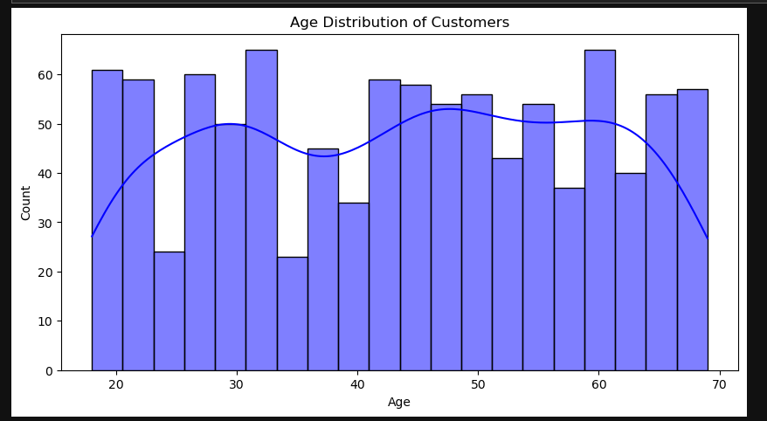
Age Distribution
Two major age groups: 25–35 and 50–60
Clear demographic clusters for targeted messaging and product design
KYC:
Step by Step

Slide 9
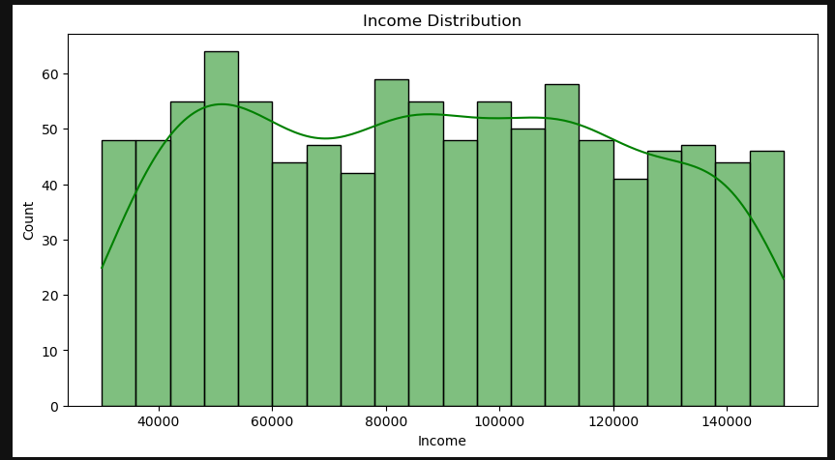
Income Distribution
Most customers earn between $80K and $110K
Broad income spread, no strong bias toward low or high incomes
Useful for tailored pricing, segmenting by purchasing power
KYC:
Step by Step

Slide 10
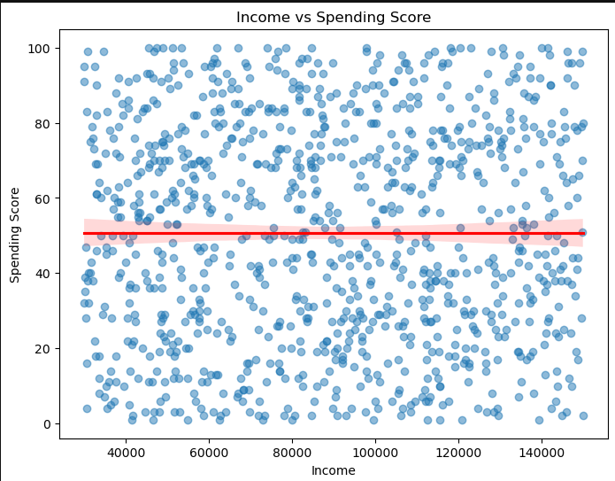
Income vs Spending score
Regression line is almost flat
The data revealed a weak relationship between income and spending score — higher income doesn’t necessarily mean higher spending.
KYC:
Step by Step

Slide 11
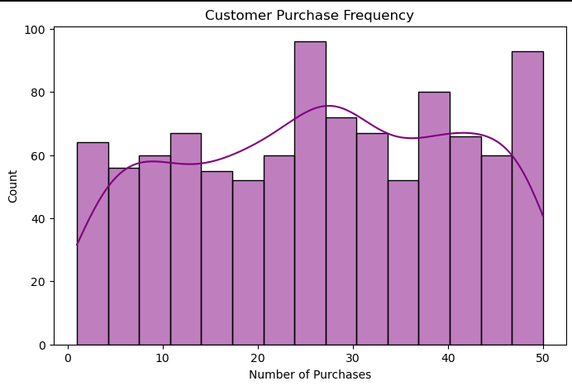
Income vs Spending score
The data revealed two buyer groups: frequent and infrequent purchasers.
This insight supports targeted marketing and promotion strategies..
KYC:
Step by Step

Slide 12
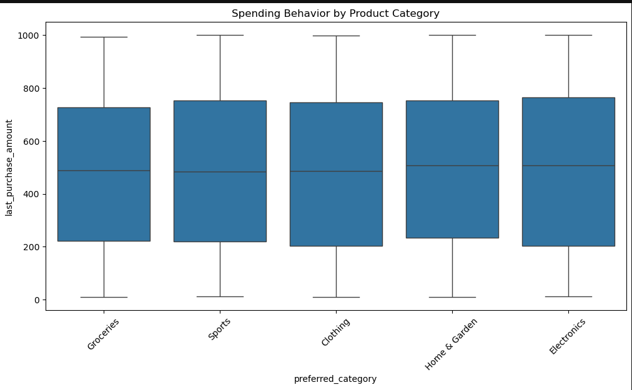
Spending by product category
Spending is consistent across product categories, with no extreme outliers.
High variability among customers suggests different spending habits, not tied to product type
Strategy should focus on customer behavior, enabling personalized offers and loyalty-driven promotions.
KYC:
Step by Step

Slide 13
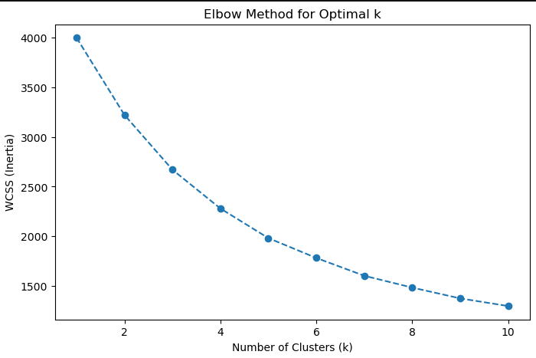
Clustering
After analyzing key customer attributes—age, income, spending habits, and purchase frequency—we proceeded with customer segmentation using K-Means clustering.
The elbow method revealed that 3–4 clusters provided the best balance between simplicity and accuracy. This set the foundation for uncovering actionable customer segments..
KYC:
Step by Step

Slide 14
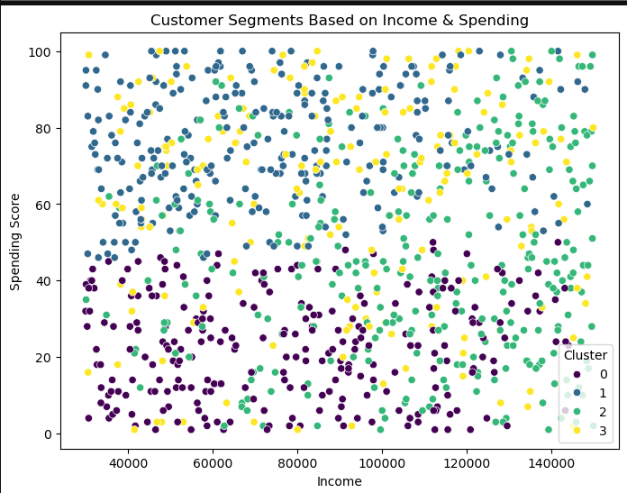
🔵 High Income – High Spending Premium buyers with strong purchasing power
🟣 High Income – Low Spending-Budget-conscious individuals with potential for upselling.
🟡 Low Income – High Spending Loyal or impulsive shoppers worth nurturing with tailored offers.
🟢 Low Income – Low Spending Cost-sensitive customers needing value-driven engagement.
KYC:
Step by Step

Slide 15

Targeting strategies
High-income groups don’t always spend more.
Multi-Dimensional Segmentation
WHY?
Some low-income customers are highly engaged
Loyalty isn't always tied to income
Retention efforts aligned to behavior, not just demographics
Personalized offers

Slide 16
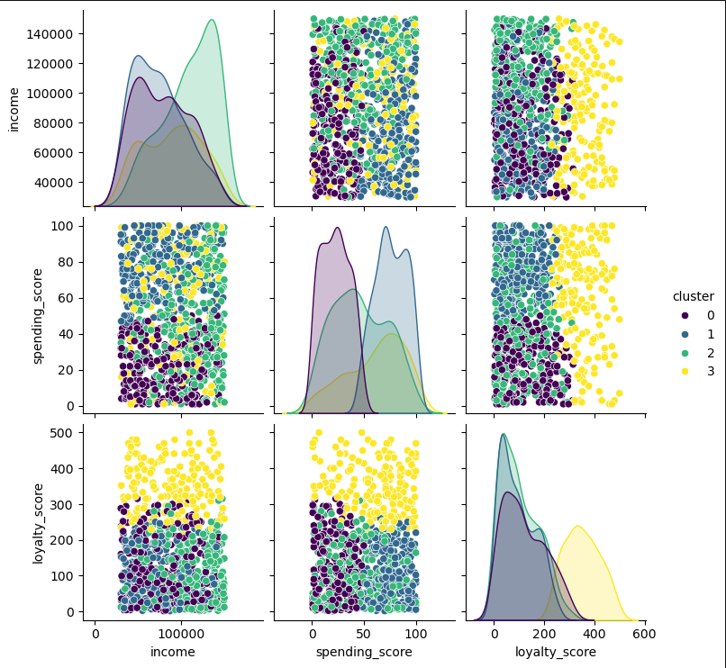
Analysis using the pair plot revealed:
Clusters based on Income, Spending Score, and Loyalty Score., where:
Income varies by cluster – Green cluster represents high-income; others fall within mid-to-lower ranges.
Spending isn’t tied to income – Blue and green clusters spend more despite varying income levels
Loyalty differs across groups – Yellow cluster stands out with the highest loyalty score.

Slide 17
Cluster 2
Cluster 3
Cluster 0
Cluster 1
Brand Advocates
At-Risk High Spenders
Low-Value Segment
Growth Opportunity
Winning Segment – Cluster 2 (304 Customers)
At-Risk Segment – Cluster 3 (176 Customers)
Low-Value Segment – Cluster 0 (254 Customers)
Middle Ground – Cluster 1 (266 Customers)
Moderate loyalty and spending
Solid foundation with potential to grow
Educate on loyalty benefits to move them into Cluster 2)
Encourage repeat purchases with targeted programs
High loyalty and high spending behavior
These are your most valuable, committed customers
Reward with early access to sales, tiered loyalty benefits, and VIP experiences
High spending but low loyalty
May include deal-seekers or one-time buyers
Investigate churn drivers Offer incentives for continued engagement
Low engagement and minimal spending
May not deliver high ROI
Run low-cost re-engagement campaigns Monitor for potential churn and deprioritize if no response)

Slide 18
For the detailed Notebook, check out my portfolio on GitHub through the link below:
https://github.com/IngridNya/-customer-segmentation/tree/main
THANK YOU

